Slide 1
SIMPLE HANDWRITTEN MATH EXPRESSION RECOGNIZE
NG ZI XING

Slide 2
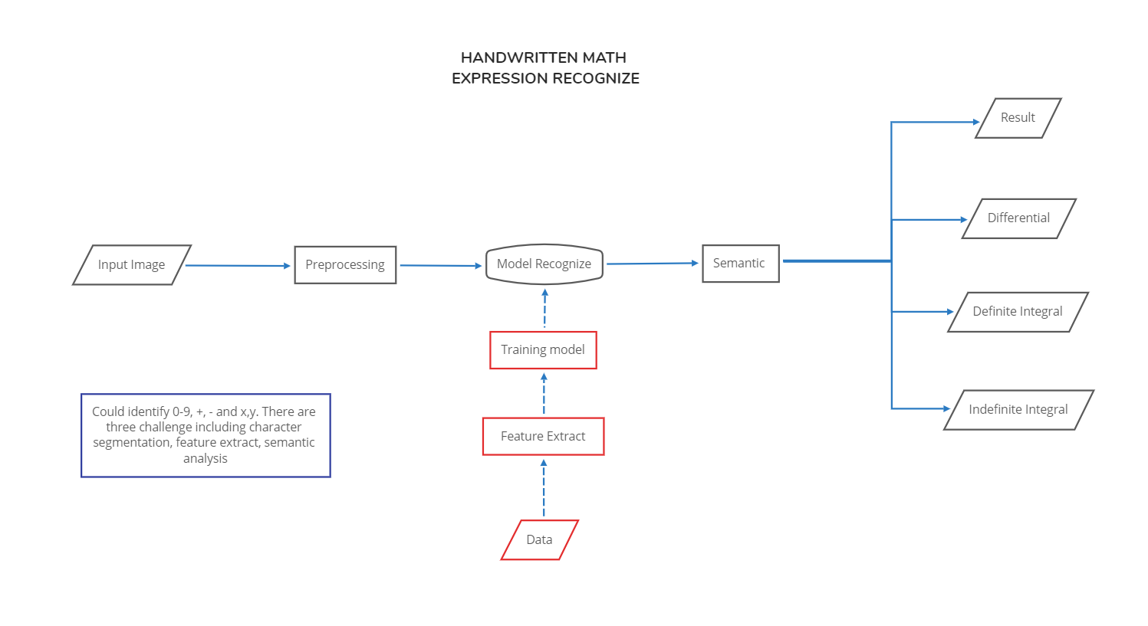

Slide 3
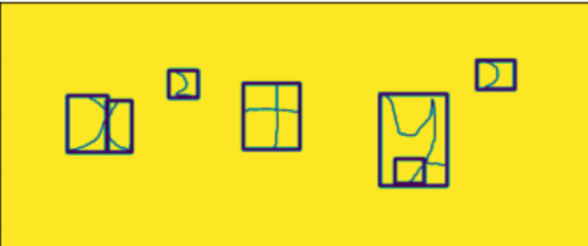
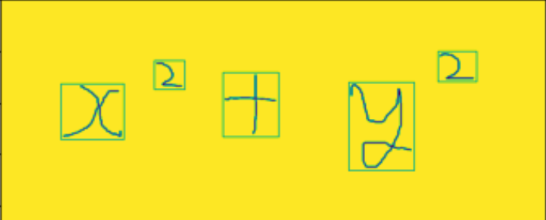

Character Segmentation
cv2.findContours
cv2.boundingRect
Second findContours to combine the border
First findContours
Segment and resize

Slide 4
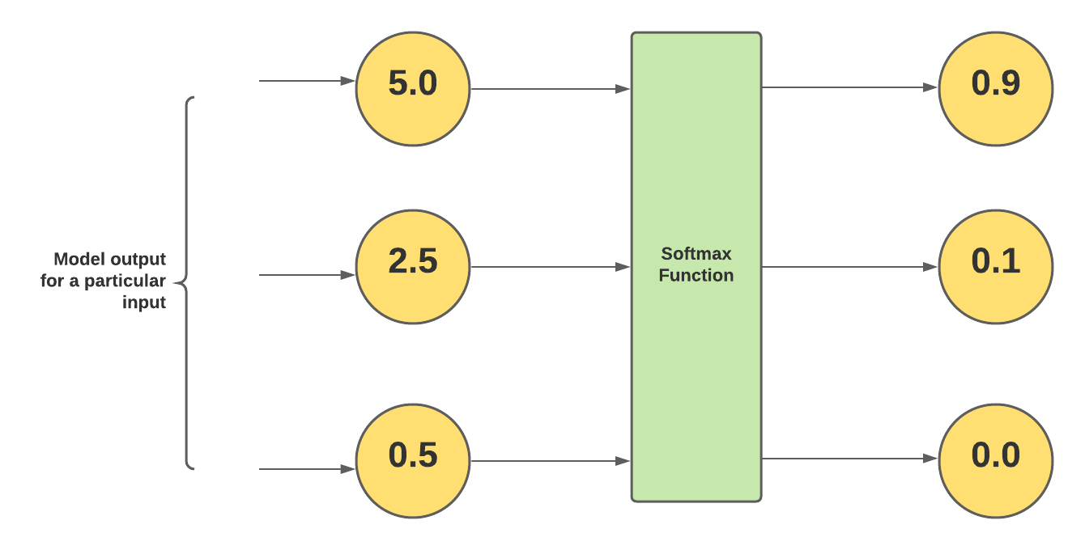
Convolutional Neural Network (CNN)

Slide 5

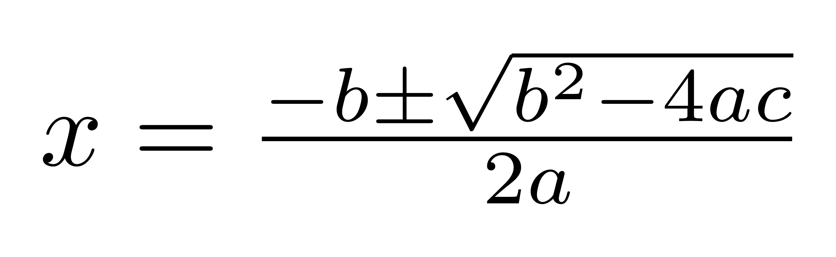
Semantic Analysis
The expression +2+3-1- is impossible and will lead to error, so I have to replace them
This is totally difference with word recognize

Slide 6
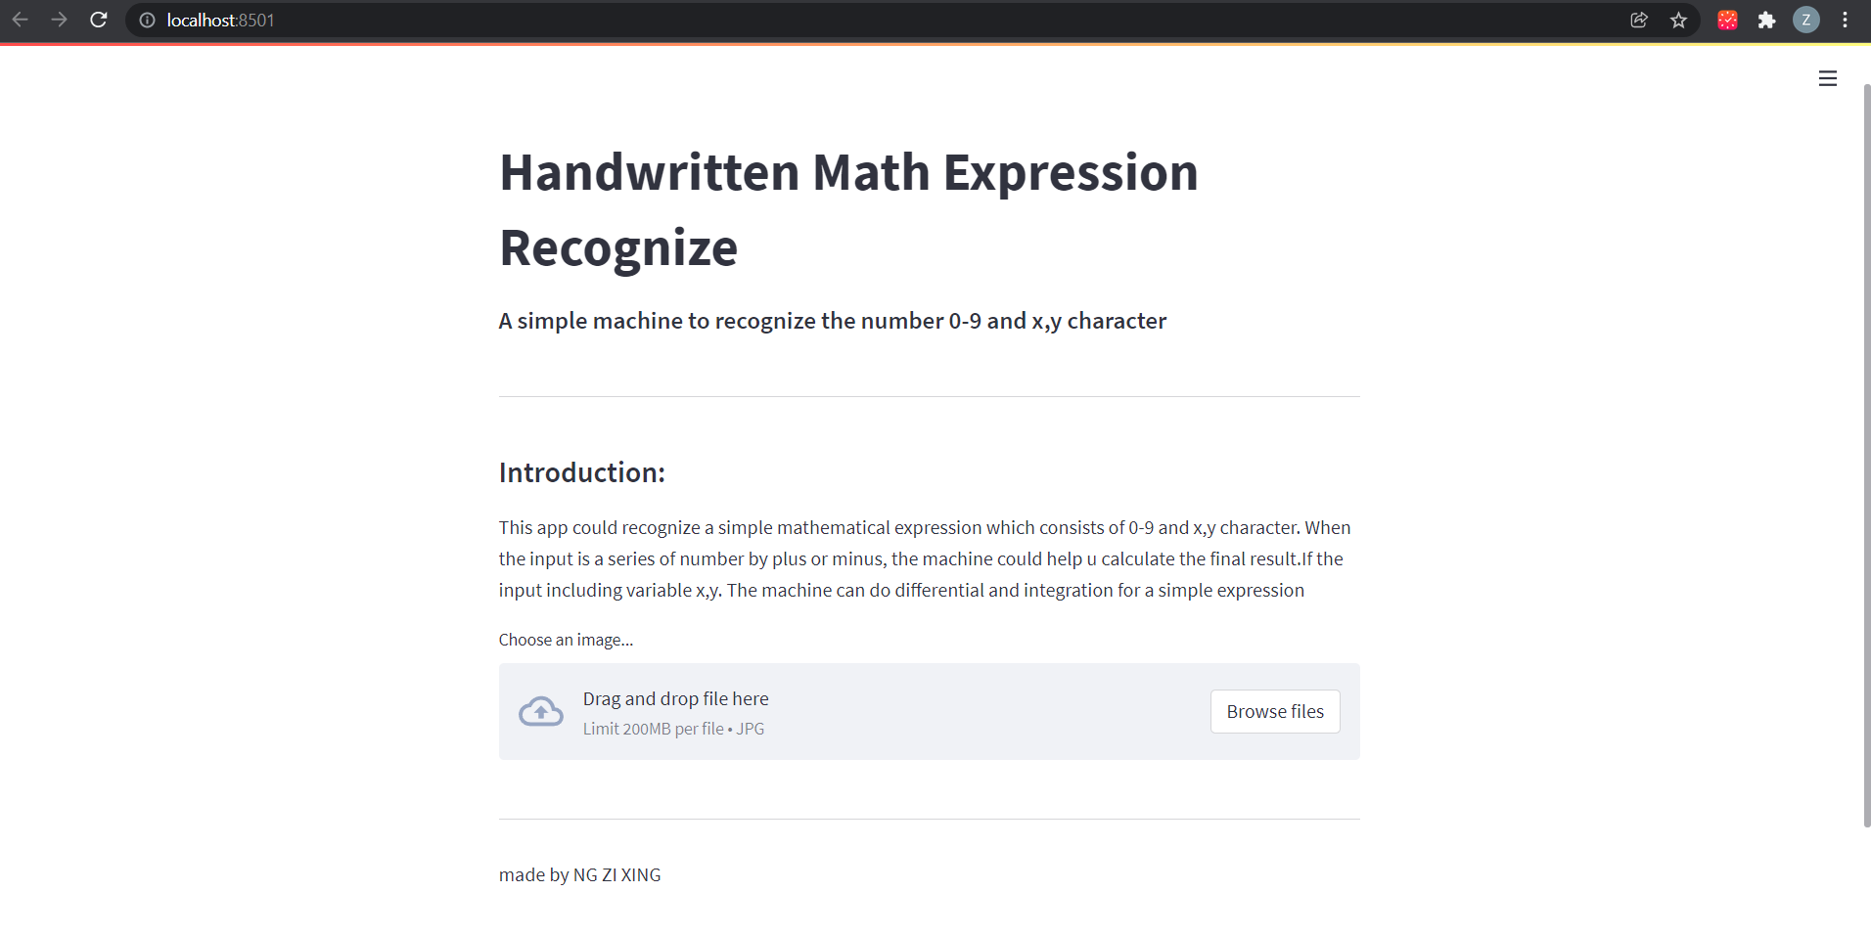
Web App build

